Slide 1
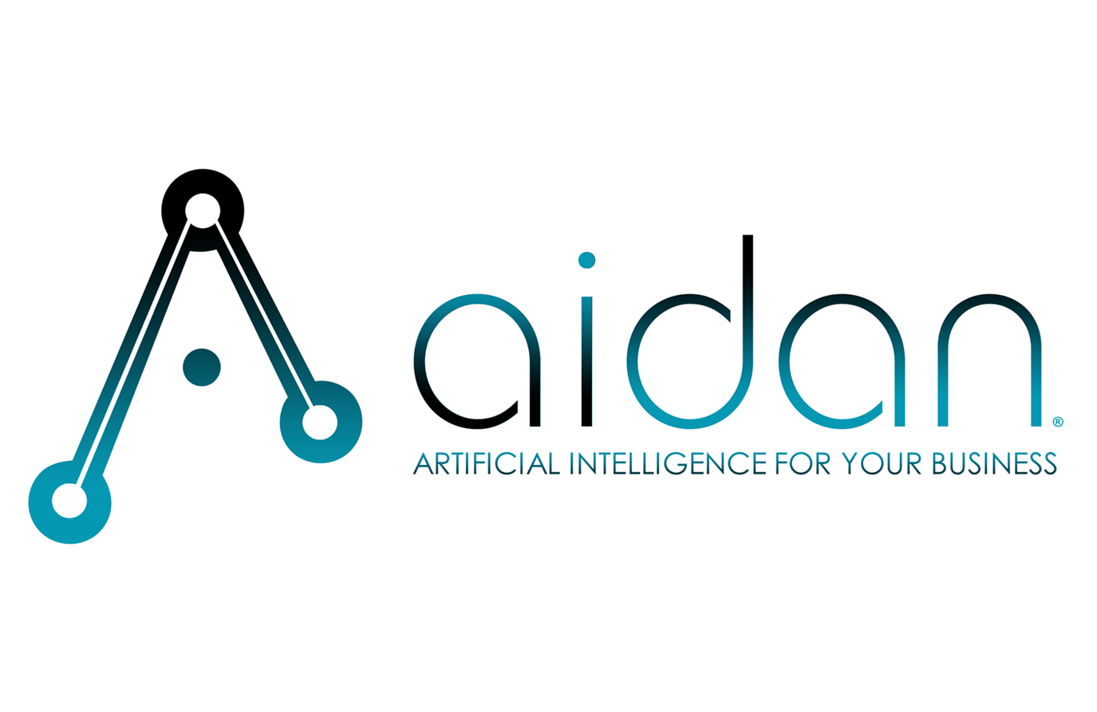
from ground to air
Gent Machine — Davenport Maintenance Assistant
Phase 2: Managed AIR
Aidan Systems · MAGNET · March 2026

Slide 2
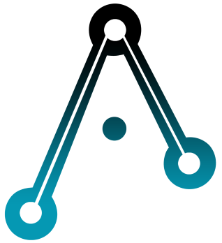
ai — a new operating altitude
speed at scale
intelligence that compounds
reach without friction
Decisions that took days happen in seconds. Work runs autonomously.
Every interaction makes the system smarter. AI accelerates the more you use it.
Real-time insight across operations — without the coordination overhead.
This isn’t about doing the same things faster. It’s about operating at a level that wasn’t previously possible.
2

Slide 3
where we are
Phase 1 complete — AI maintenance assistant live on the shop floor
Dave’s expertise captured: 1,241 documents indexed, 570-vertex knowledge graph
Real machinists asking real questions (thrust bearings, thread peaks, short parts)
System delivers step-by-step, source-cited guidance in seconds
Currently in the Adopt stage — system works, needs more knowledge and more pilots
Status: WHEELS UP
3

Slide 4
the opportunity
Gent has more Davenport capacity than can currently be staffed
Dave has retired — his knowledge is in the system, not walking around
The bottleneck isn’t equipment — it’s skilled people
The AI cockpit lets less experienced operators perform at expert level
Each additional Davenport brought online = $120,000–$168,000/year in new revenue
Phase 2 isn’t about protecting what you have. It’s about growing what you can do.
4

Slide 5
the industrial pilot
How we enable your team
 | Traditional | Industrial Pilot (with Aidan)
Leadership | Manager — monitors and controls | Flight Instructor — coaches your team to fly solo with AI
Worker | Employee — does tasks, waits for the expert | Pilot — navigates independently with AI-powered instruments
Environment | Workplace — clock in, do the job | Airframe — the AI platform that everything runs on
Culture | Silos — knowledge stuck in individual heads | Shared Airspace — everyone’s knowledge available to everyone, 24/7
Visibility | Time card — hours worked | Altitude Report — performance visibility across all cockpits
5

Slide 6
the flight path
Six stages from ground to air
Stage | Flight Term | Business Term | Status
0 | PRE-FLIGHT | Assess | ✓ Complete
1 | CONFIGURE | Configure & Deploy | ✓ Complete
2 | TAXI | Train & Tune | ✓ Complete
3 | TAKE OFF | Adopt & Hypercare | ← You are here
4 | CLIMBING | Build Skills & Trust | Next
5 | CRUISING | Compound | Goal
6

Slide 7
three value pillars
scale
capability
redundancy
Get more machines running. A junior hire paired with the AI cockpit can operate a Davenport that would otherwise sit idle.
Raise the floor across all operators. Every machinist gets expert-level troubleshooting — consistent quality, faster changeover.
Remove single points of failure. No one person is a bottleneck. Every shift has the same knowledge available.
7

Slide 8
take off — adopt
Months 1–3: What we’re going to do
"Ask the Cockpit First" — team expectation set by Rich
Close known knowledge gaps (extension pin, oil specs, thrust bearing brands)
Get Dave engaged remotely — reviewing answers on his phone, flagging what’s wrong
Content sprint: cover top troubleshooting scenarios
Shop floor display board — weekly visibility
Biweekly coaching calls with Rich
Monthly Altitude Report posted on the shop floor
Target: 2+ queries per machinist per week · 70%+ top scenarios covered · Feedback flowing from Dave and the team
8

Slide 9
climbing to cruising
Months 4+: Expand and compound
Add setup procedures to KB — enables less experienced operators
Altitude Report live — leaderboard, personal stats, team progress
Growth planning: which jobs can a junior hire handle with cockpit support?
When ready: add a New Leg to the airframe ($10,500)
System is comprehensive — daily use, value compounding
Target: 5+ queries/week · 70%+ satisfaction · Setup procedures indexed · Growth path identified
9

Slide 10
managed air — service tiers
 | Cruise Compound Benefits | Climb Building Skills & Trust | Take Off Adopt - Hypercare
Monthly Fee | $800/mo | $1,600/mo | $2,400/mo
Azure Infrastructure | ✓ Included | ✓ Included | ✓ Included
SOC 2 Compliance | ✓ Included | ✓ Included | ✓ Included
Altitude Report | Monthly | Monthly | Biweekly
System Adjustments | Minor | Proactive | Aggressive
Expert Onboarding | — | — | ✓
Knowledge Base Development | — | ✓ | Intensive – aggressive feedback
Agent Tuning | — | ✓ | Intensive - Jargon
Coaching Call | — | Monthly | Biweekly
10

Slide 11
expand the airframe
full throttle — solution expansion
new leg — new work center
$1,500 per story point · 2–4 points ($3,000–$6,000)
$10,500 · 7 story points at $1,500/point
New knowledge areas or deep content buildout
Search quality overhaul or retrieval tuning
Scoped improvement sprint
Full Configure for a new machine type on the airframe
Expert interviews, document ingestion, knowledge graph
Agent configuration, tuning, and shop floor testing
Same monthly Managed AIR covers all work centers
More legs on the airframe, more value per dollar.
11

Slide 12
managed air
Your AI operating system
monitoring & health
training & enablement
continuous improvement
Continuous surveillance — catch issues before failures
Your people become confident, capable AI users
Models evolve, outcomes accelerate — value compounds
change management
governance
data quality
Sense and respond as the landscape shifts
Policies current, data quality maintained, risks managed
Clean, current, trustworthy data — AI is only as good as what you feed it
12

Slide 13
without vs. with managed air
without managed air
with managed air
System drifts — no one maintaining or improving
Team reverts to old habits
Knowledge gaps stay open — trust erodes
Phase 1 investment slowly goes to waste
Performance tracked and reported monthly
Team coached through adoption
Knowledge base grows — system gets smarter every month
Phase 1 investment compounds into real growth
13

Slide 14
the ask
Start at Medium tier for 6 months to drive adoption
Drop to Small once the system is self-sustaining
Less than the cost of one extended downtime incident per month
When ready to expand: Full Throttle sprints or New Legs on the airframe
Period | Tier | Focus
Months 1–3 | Take-Off | Drive daily use, close gaps, coaching cadence | $2400 / month
Months 4–9 | Climb | Add setup procedures, Altitude Report, growth planning | $1600 / month
Month 10+ | Cruise | Sustain, support new hires, enable expansion | $800 / month
 |  |  | $19,200 year 1
14

Slide 15
the return on investment
Each additional Davenport running: $120K–$168K/year in new revenue
2%+ efficiency improvement across existing machines
Faster onboarding: new hires productive in weeks, not months
Knowledge insurance: Dave’s expertise available 24/7, permanently
3×
Return on Managed AIR investment
 | Revenue Base | Profit-Savings | Cost | ROI
1+ Davenport | $140 k for ½ year | @35% = $25 k
2% efficiency | 10 x $140 k | @ 2% = $28 k
Onboard Savings | 1 hire x 3 months faster | 3 x $2k = $6 k
Total |  | $59 k | $19.2 k | $39k, 3x
15

Slide 16
The question is how many more machines could be running if the skills bottleneck were removed — and the knowledge to do that is already in the system.
Aidan Systems · MAGNET · March 2026
16

